Slide 1
Scalable Multi-class Classification

Slide 2
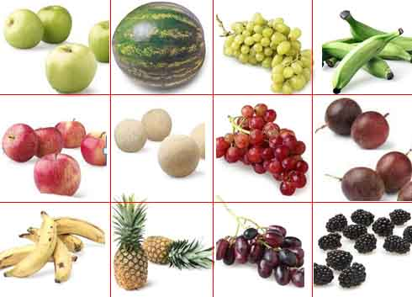
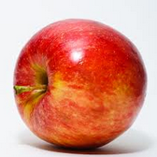
What is multi-class classification ?
Each an instance belongs to one of N different classes.
The goal is to construct a function which, given a new data point, will correctly predict the class to which the new point belongs.
Source: http://www.mdpi.com/1424-8220/12/9/12489

Slide 3
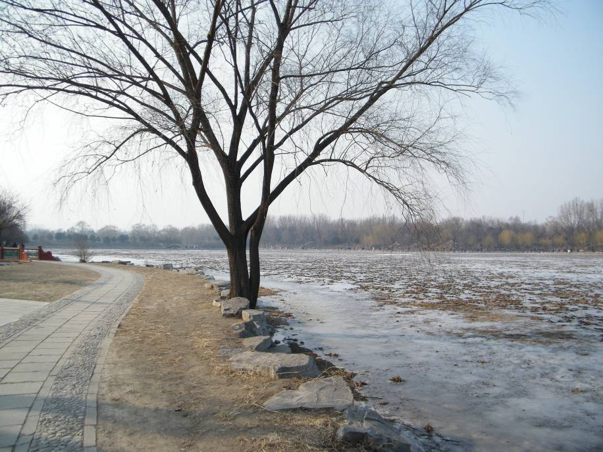
What is multi-label classification ?
An instance may be associated with multiple target labels.
Multi-label learning can be phrased as the problem of finding a model that maps inputs x to vectors y.
Tree
Winter
Park
Ice
Lake
Source: www.cs.columbia.edu/~wfan/PPT/sdm10rdt.ppt

Slide 4
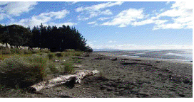
multi-class vs multi-label
Given :
a pre defined set of class-labels, e.g.
L = {beach, trees, urban, people} and
a set of instances from an input domain, e.g.
Multi-class (single-label) classification : examples are associated with a single class label; e.g. beach.
Multi-label classification: examples are associated with a label subset: e.g. {beach, trees}.
Source:www.tsc.uc3m.es/~jesse/talks/Charla-Malaga.pdf

Slide 5
Methods
The first class is generic and treats the label space as “flat”.
One –vs – All classification
One –vs-One classification
(using winner-takes-all)
The second class of methods reduces the test time by exploiting the hierarchical structure/tree. The hierarchy is constructed by
recursive top-down partitioning.
bottom-up agglomerative clustering

Slide 6
Multiclass SVM
Extend SVM for multi-classes separation
N_{c} = number of classes
Class 2
Class 1
Class 5
Class 4
Class 3

Slide 7
Two approaches
Class 1
Class 2
Class 3
Class 4
1-vs-rest
1-vs-1
DAGSVM
Combine multi-binary-classifiers
Generate one function based on single optimization problem

Slide 8
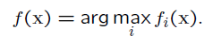
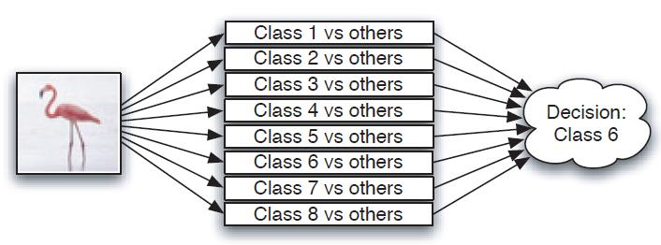
One-vs-All/ 1-vs-rest
Build N different binary classifiers.
For the i^{th} classifier, let the positive examples be all the points in class i, and let the negative examples be all the points not in class i.
Let f_{i} be the i^{th} classifier. Classify with
Complexity O(N)
Rifkin et al., JMLR 2004
Notes:
For each classifier, the class is fitted against all the other classes.
In addition to its computational efficiency (only n_classes classifiers are needed), one advantage of this approach is its interpretability.
Since each class is represented by one and one classifier only, it is possible to gain knowledge about the class by inspecting its corresponding classifier

Slide 9
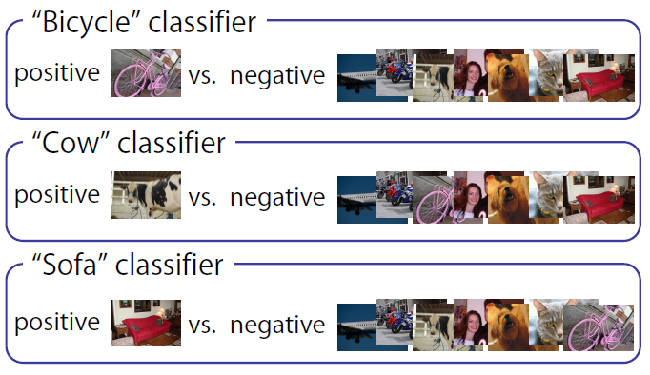
1-vs-rest
The classifiers are learned independently

Slide 10
1-vs-rest
Class 2
Class 1
Class 4
Class 3

Slide 11
1-vs-rest
Class 2
Class 1
w₁
w₂
N_{c} classifiers
w₄
w₃
Class 3
Class 4

Slide 12
1-vs-rest
Class 2
Class 1
w₁
w₂
q
~ Similarity(q,SV₃)
~ Similarity(q,SV₂)
w₁^{T}q+b₁ ~ Similarity(q,SV₁)
~ Similarity(q,SV₄)
w₄
w₃
Class 3
Class 4

Slide 13
1-vs-rest
Class 2
Class 1
w₁
w₂
q
Label(q)=
argmax_{1≤i ≤Nc}{Sim(q,SV_{i})}
w₄
w₃
Class 3
Class 4

Slide 14
1-vs-rest
After training we’ll have N_{c} decision functions:
f_{i}(x)=w_{i}^{T}x+b_{i}
Class of query object q is determined by:
argmax_{1≤i ≤Nc}{ w_{i}^{T}x+b_{i} }
Pros:
Only N_{c} classifiers to be trained and tested
Cons:
Every classifier use all vectors for training
No bound on generalization error

Slide 15
1-vs-rest Complexity
For training:
N_{c} classifiers, each using n vectors for finding hyperplane
For classifying new objects:
N_{c} classifiers, each is tested once, M=max number of SV

Slide 16
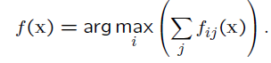
One-vs-One Classification
Build N(N −1)/2 classifiers, one classifier to distinguish each pair of classes i and j = {c₁c₂, c₁c₃, c₁c₄, …, c_{n-1}c_{n}}
Let f_{ij} be the classifier where class i were positive examples and class j were negative. Classify using
Complexity O(N²)
Also called all-pairs or all-vs-all classification.
Note: f_{ij} ∈{1,-1} and f_{ji} = −f_{ij}.
Hastie et al, NIPS’97
Notes:
At prediction time, the class which received the most votes is selected.
this method is usually slower than one-vs-all due to its O(N^2) complexity

Slide 17
1-vs-1
Class 2
Class 1
Class 4
Class 3

Slide 18
1-vs-1
W_{1,2}
Class 2
Class 1
W_{1,4}
W_{1,3}
W_{2,4}
N_{c}(N_{c}-1)/2 classifiers
W_{2,3}
Class 4
Class 3
W_{3,4}

Slide 19
1-vs-1 with Max Wins
☺
☺
☺
☺
W_{1,2}
Class 2
Class 1
W_{1,4}
q
Sign(w_{1,2}^{T}q+b_{1,2}) ~ 1 or 2 ?
~ 2 or 4 ?
W_{1,3}
~ 1 or 3 ?
W_{2,4}
~ 1 or 4 ?
~ 3 or 4 ?
W_{2,3}
~ 2 or 3 ?
Class 4
Class 3
W_{3,4}
☺
☺

Slide 20
1-vs-1 with Max Wins
☺
☺
☺
☺
W_{1,2}
Class 2
Class 1
W_{1,4}
q
W_{1,3}
W_{2,4}
W_{2,3}
Class 4
Class 3
W_{3,4}
☺
☺

Slide 21
1-vs-1 with Max Wins
After training we’ll have N_{c}(N_{c}-1)/2 decision functions:
f_{ij}(x)=sign(w_{ij}^{T}x+b_{ij})
Class of query object x is determined by max-votes
Pros:
Every classifier use a small set of vectors for training
Cons:
N_{c}(N_{c}-1)/2 classifiers to be trained and tested
No bound on generalization error

Slide 22
1-vs-1 Complexity
For training:
Assume that every class contains ~ n/N_{c} instances
N_{c}(N_{c}-1)/2 classifiers, each using ~2n/N_{c} vectors:
For classifying new objects:
N_{c}(N_{c}-1)/2 classifiers, each is tested once, M as before

Slide 23
What did we have so far?
Class 1
Class 1
Class 2
Class 2
Class 4
Class 4
Class 3
Class 3
1-vs-1 | 1-vs-rest
N_{c}(N_{c}-1)/2 | N_{c} | # of classifiers (each need to be trained and tested)
~2n/N_{c} | n (all vectors) | # of vectors for training (per classifier)
No bound on generalization error
Notes:
להזכיר שכשהאימון נעשה על מס' דוגמאות קטן זה אמנם יתרון מבחינת סיבוכיות, אך יכול להיות חסרון מבחינת ביצועים

Slide 24
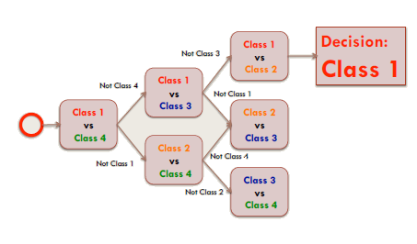
Decision Directed Acyclic Graph
combine many two-class classifiers into a multiclass classifier
Complexity O(N)
J. C. Platt et al., Large margin DAGs for multiclass classification. NIPS, 1999.

Slide 25
DAGSVM
1-vs-1
Decision DAG (DDAG)
W_{1,2}
1 2 3 4
1 vs 4
Class 2
Class 1
not 1
not 4
W_{1,4}
2 3 4
2 vs 4
1 2 3
1 vs 3
W_{1,3}
W_{2,4}
W_{2,3}
not 2
not 4
not 1
not 3
Class 4
3 4
3 vs 4
2 3
2 vs 3
1 vs 2
1 2
Class 3
W_{3,4}
4
3
2
1
J. C. Platt et al., Large margin DAGs for multiclass classification. NIPS, 1999.

Slide 26
DDAG on N_{c} Classes
Single root node
1 2 3 4
1 vs 4
not 1
not 4
In every node:
Binary decision function
N_{c}(N_{c}-1)/2 internal nodes
2 3 4
2 vs 4
1 2 3
1 vs 3
DAG
not 2
not 4
not 1
not 3
3 vs 4
2 vs 3
1 vs 2
3 4
2 3
1 2
N_{c} leaves,
one per class
4
3
2
1

Slide 27
Building the DDAG
1
2
3
4
1 2 3 4
1 vs 4
change list order
no affect on results
not 1
not 4
2 3 4
2 vs 4
1 2 3
1 vs 3
not 2
not 4
not 1
not 3
3 vs 4
2 3
2 vs 3
1 vs 2
3 4
1 2
4
3
2
1

Slide 28
Classification using DDAG
W_{1,2}
~ 1 or 2 ?
1 2 3 4
1 vs 4
q
Class 2
Class 1
~ 1 or 4 ?
not 1
not 4
W_{1,4}
~ 1 or 3 ?
2 3 4
2 vs 4
1 2 3
1 vs 3
W_{1,3}
W_{2,4}
W_{2,3}
not 2
not 4
not 1
not 3
3 4
3 vs 4
2 3
2 vs 3
1 vs 2
1 2
Class 4
Class 3
W_{3,4}
4
3
2
1
Notes:
בהנחה שה-classes ניתנים להפרדה והשוליים שמתקבלים אכן גדולים אזי הגיוני "להיפטר" מה-class שלא בחרנו לסווג אליה בכל פעם.

Slide 29
DAGSVM
Pros:
Only N_{c}-1 classifiers to be tested
Every classifier uses a small set of vectors for training
Bound on generalization error (~margins size)
Cons:
Less vectors for training → worse classifier?
N_{c}(N_{c}-1)/2 classifiers to be trained

Slide 30
DAGSVM Complexity
For training:
Assume that every class contains ~n/N_{c} instances
N_{c}(N_{c}-1)/2 classifiers, each using ~2n/N_{c} vectors:
For classifying new objects:
N_{c}-1 classifiers, each is tested once
M = max number of SV

Slide 31
Multiclass SVM
DAGSVM | 1-vs-1 | 1-vs-rest
 |  | N_{c} | # of classifiers
O(Dּn²) | O(Dּn²) | O(DּN_{c}n²) | Training complexity
O(M₂ּN_{c}) | O(M₂ּN_{c}²) | O(M₁ּN_{c}) | Classification complexity

Slide 32
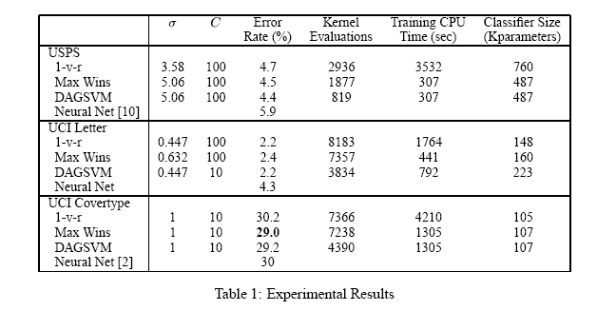
Multiclass SVM comparison
Classification Training

Slide 33
Multiclass SVM - Summary
1-vs-rest | DAGSVM / 1-vs-1
O(DּN_{c}ּn²) | O(Dּn²)
Training:
Classification:
Error rates:
Bound of generalization error - only on DAGSVM
In practice – 1-vs-1 and DAGSVM
The “one big optimization” methods
Similar error rates
Very slow training – limited to small data sets
1-vs-1 | DAGSVM / 1-vs-rest
O(DּMּN_{c}²) | O(DּMּN_{c})

Slide 34
Problem
What happens as the number of classes increases ?
The cost for training and testing will linearly increase with the number of classes.
The distinction between classes will be decreased → accuracy will be decreased.
Diversity of images within classes.
E.g.
Caltech-256: 30,607 images, 256 categories
SUN Dataset: 131,072 images, 908 scene categories
LSVRC 2013: 1.2 million images, 1000 categories

Slide 35
Hierarchical Classification
Basic Idea:
observing that object categories are naturally hierarchical,
Proposing hierarchical classification.
Classifier
Entity
Animal
Vehicle
internal
nodes
Cat
Dog
Boat
Car
Bird
leaf nodes
i^{th} class label

Slide 36
Constructing hierarchical tree
The hierarchical tree is constructed by
By hand (Zweig et al, ICCV2007)
From external sources (e.g. Wordnet,…) (Li-Jia Li , CVPR2010)
From semantic/visual similarities:
recursive top-down partitioning
bottom-up agglomerative clustering

Slide 37
Types of hierarchies
Types of hierarchies:
Language-based hierarchy
Low-level visual feature based hierarchy.
Language and visual feature based hierarchy

Slide 38

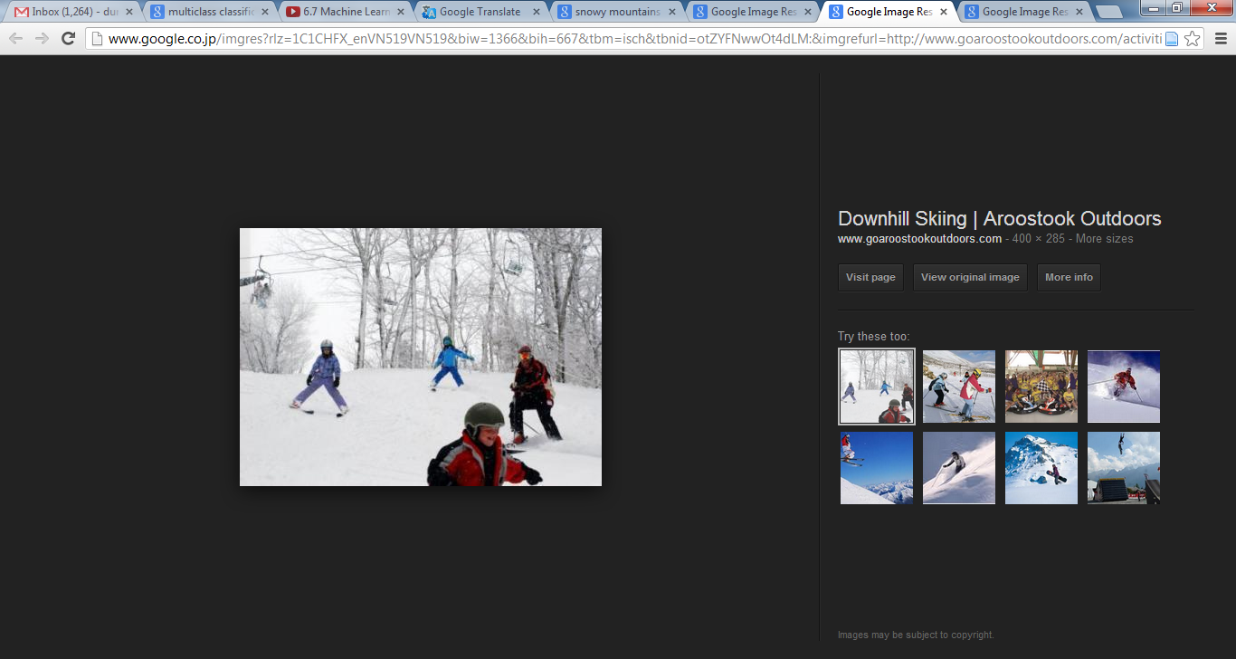
Types of hierarchies
Language-based hierarchy
+ Be useful to guide the meaningful organization of images;
- ignore important visual information that connects images together.
(e.g. concepts such as snowy mountains and a skiing activity are far from each other on the WordNet hierarchy, while visually they are close)
snowy mountains
skiing activity

Slide 39
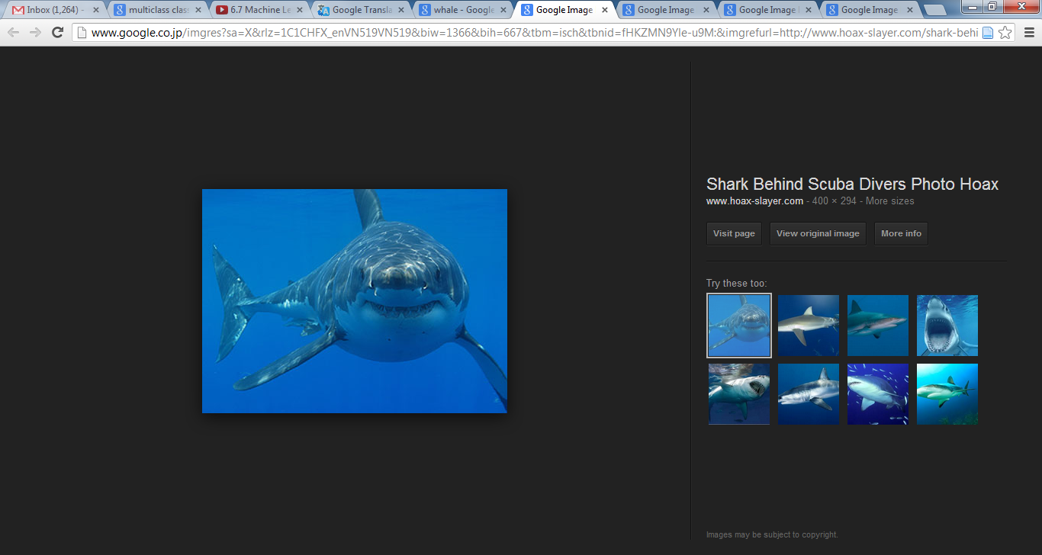
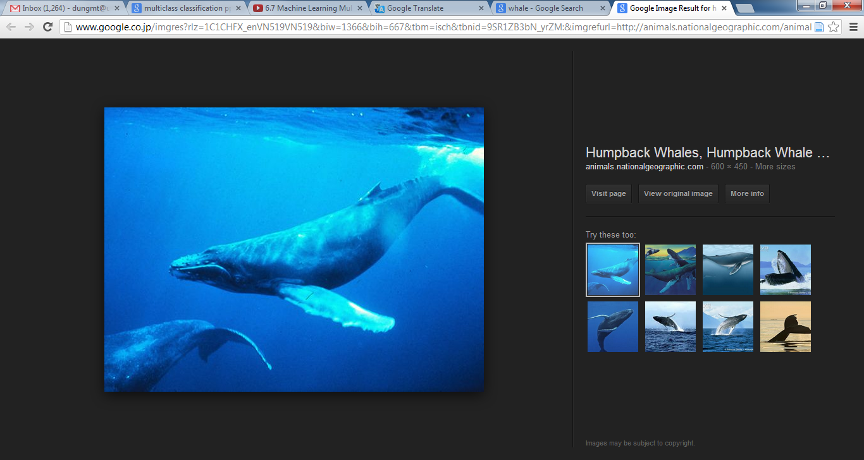
Types of hierarchies
Low-level visual feature based hierarchy.
+ visually similar objects and concepts (e.g. shark and whale) should be close neighbors on an image hierarchy,
- be difficult to interpret.
shark
whale

Slide 40
Open Research Question
What is the best way to build hierarchies for object category classification?
Top-down vs. bottom-up
How to choose splits at each node

Slide 41
Case studies

Slide 42
Taxonomies Griffin et al. , CVPR 2008
Basic concept
Categories that are easily confused should be grouped together;
Decisions between easily-confused categories should be taken later in the decision tree.
How it works
Construct confusion matrix from training data
Building Taxonomies – Bottom up
Re-train top-down classifiers
Limitation
model class hierarchies with trees leads to separation problems when the number of categories increases.

Slide 43
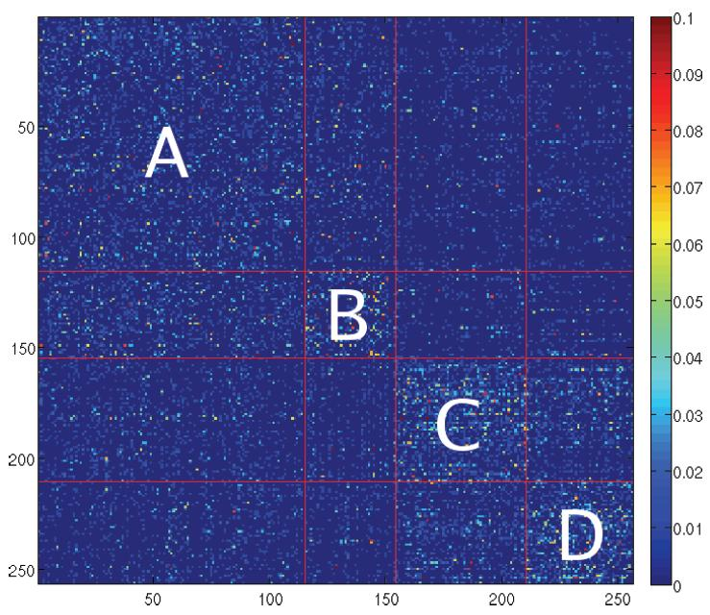
Taxonomies Griffin et al., CVPR 2008
Construct confusion matrix from training data
Train multi-class SVM with Spatial Pyramid Matching kernel
One vs. all classification scheme

Slide 44
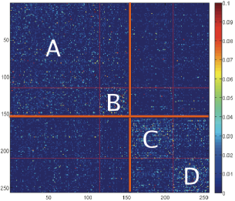

Taxonomies Griffin et al. , CVPR 2008
Splitting the Confusion Matrix – Top Down
Recursively split the confusion matrix into two parts based on the Self-Tuning Spectral Clustering algorithm
Repeat process until leaves each have one category

Slide 45
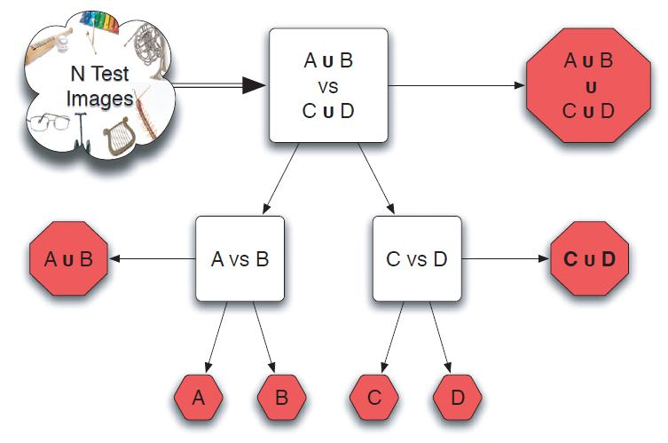
Taxonomies Griffin et al. , CVPR 2008
Building the Taxonomy – Bottom Up
Start with each category in its own group
Pick two groups with the most mutual confusion and combine into a larger group
Continue until there is one group that contains all the categories

Slide 46
Taxonomies Griffin et al. , CVPR 2008
Training the Branch Classifiers
Known the taxonomy tree of categories as a binary tree
Each branch node is trained on the training images for the classes used in the decision
Picked a random subset for SVM training
F_{train} = 10%
Split sampled training examples into two “classes”
Trained an SVM for those two “classes”
Spatial Pyramid Matching kernel again
5x speed up with 10% performance drop

Slide 47
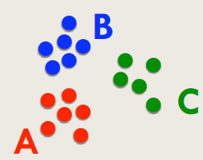
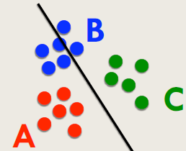
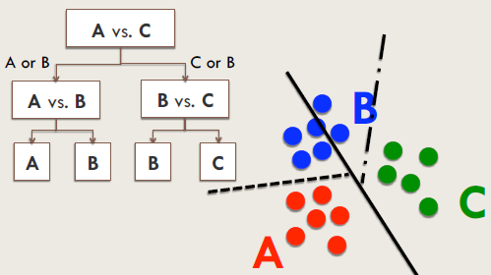

Relaxed hierachy Marszaklek, ECCV 2008
Basic concept
As # of classes grows, finding partitions in the feature space becomes more difficult.
→ Avoid disjoint partitioning by postponing difficult classification decisions.
relaxed hierarchy – do not force classes that lie on a partition boundary into either partition (→ include both).

Slide 48
Relaxed hierachy Marszaklek, ECCV 2008
How it works
Building relaxed hierarchy
Train top-down classifiers using hierarchy
Limitation
Does not scale well in terms of the classification accuracy.
Complexity O(mlogK)

Slide 49
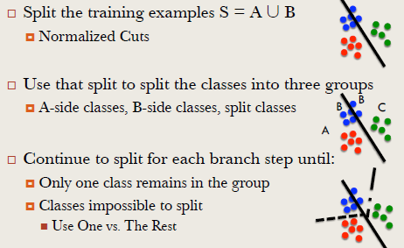
Relaxed hierachy Marszaklek, ECCV 2008
Building top-down relaxed hierarchy

Slide 50
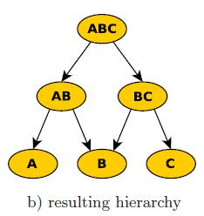
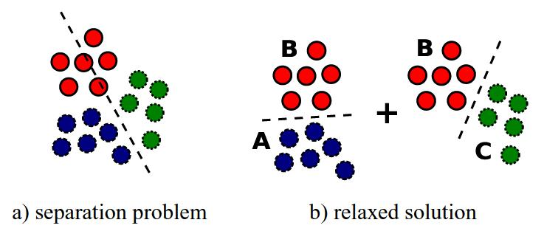
Relaxed hierachy Marszaklek, ECCV 2008
Building top-down relaxed hierarchy

Slide 51
Relaxed hierachy Marszaklek, ECCV 2008
Train/test top-down classifiers
Training hierarchy:
For each node of DAG, samples of [Ln\Rn] as positive sample, [Rn\Ln] as negative samples;
Samples in classes Xn=Ln П Rn not for training
Testing:
Traversal DAG until a leaf is reached.
The decision is either directly the class label (leaves containing one class), or performing OAR classification on the remaining classes in current leaf.

Slide 52
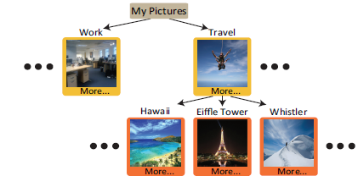
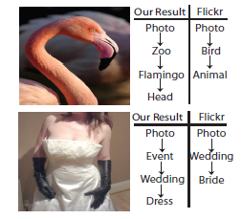
Semantivisual Image Hierarchy Li-Jia Li , CVPR2010
Creating semantic image hierarchy by incorporating both image (regions in image) and tag information.
Using top down approach ( base on Gibbs sampling algorithm)

Slide 53
Label Embedding Tree Bengio et al., NIPS 2010
Using confusion matrix and Optimizing the tree loss to build label tree.
Convert label space to embedded label space to reduce the evaluation cost.
The partitioning of classes does not allow overlap.

Slide 54
Efficient Label Tree J. Deng, NIPS 2011
Basic concept
each node is associated with a subset of class labels and a linear classifier that determines which branch to follow.
Top down approach
How it works
It partitions the classes into a fixed number of child nodes and learns the classifier weights for each of the children. It then recursively repeats for each child.
A test example travels from the root of the tree to a leaf node associated with a single class label .
Limitation
fix two parameters: the number of children Q for each node, and the maximum depth H of the tree.

Slide 55
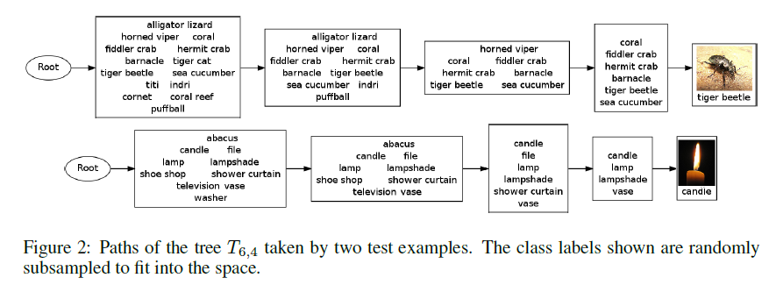
Efficient Label Tree J. Deng, NIPS 2011

Slide 56
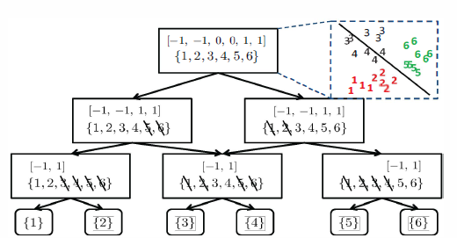
Relaxed Hierarchy Gao et al. ICCV2011
Build relaxed hierarchy
Use confusion matrix.
color the classes as one of {-I, 0, + I}, where
classes colored as -1 will be learned to separate from those with color + l.
Classes with color 0 will be ignored in the node binary classification

Slide 57
Relaxed Hierarchy Gao et al. ICCV2011
Estimating confusion matrix
Training relaxed hierarchy
Training internal nodes
Root:
get_bottom_up_initialization
sort confusion matrix.
get the pairs of classes with minimum confusions (little confusion)
Assign label:
mu{i} = zeros(num_classes, 1);
mu{i}(min_col_indx) = 1;
mu{i}(min_row_indx) = -1;
Internal
Training leaf nodes

Slide 58
Hierarchical Tree
Advantages
Computational efficiency ( testing costs are also reduced from O(K) to O(logK)).
Appropriating with the large number of classes.
Hierarchical information
Can reduce classification error ( e.g. classifying a “dog” as “cat” is probably not as bad as classifying it as “microwave”).
Be applied in image retrieval or annotation.

Slide 59
Hierarchical Tree
Disadvantages
Creating tree structure is complex.
Cost for training of classifier at each node.
Classification accuracy depend classifier at each node.
Class overlapping problem: allow/ not allow ?
Use same feature vector to traverse from root node to leaf node.
Don’t use information about density of samples in the classes.

Slide 60
Future works
Improving the relaxed hierarchy which is proposed by Gao et at, ICCV2011.
Applying on ImageCleft Dataset 2012 (94 concepts).

